Slide 1
Shell Eco Marathon
Prepared BY: Mohammed Hallawa

Slide 2
SEM TEAM
Team Mentor:
Dr. Michael Schuller
Team Supervisors:
Dr. Ziyad Shafik
Mr. Yasser Al-Hamidi
Mr. Muhammad Bin Yousaf
Team Members:
Mohammed Hallawa
Ahmad Mokahal
Mohab Hanbal
Tariq Atiyah
Doaa Awad
Jayson El Turk
Mohamed Mohamed
Jawad Yammine

Slide 3
SEM Singapore Updates/Information
SEM Asia-Singapore at Changi Exhibition center from March 16th -19th, 2017.
Length of track is 12 km (10 laps, 1.2 km each).
To be completed in 28 minutes.
Urban Category- GTL Diesel.
Sponsors; TAMUQ, Qatalum, QTC, ATCC.

Slide 4
Need Statement

Slide 5
Input:
1-Oil Temp Sensor
2- Speed Sensor
3- RPM Sensor
4- Engine Bay Temp Sensor
5- Flow Meter Sensor
6- Tire Pressure Sensors
Output:
LCD Screen displaying readings by sensors
Raspberry PI
Convertor
12V/5V
DC/DC
Lithium Battery (DC)
12 Volts
10 Ampere
Convertor
12V/12V
DC/DC
Switches:
Brake Light Lights Indication Lights On/Off Switch
Fuse Box (Protection)

Slide 6
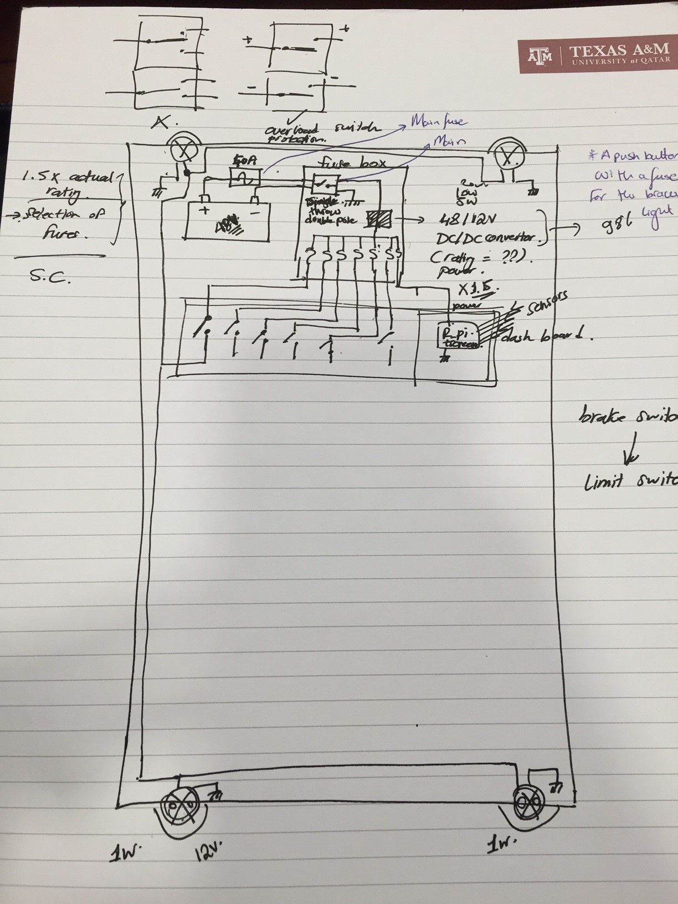
Design implemented.

Slide 7
Circuit Design.
Car chassis and Body.
Car Schematic Design.
Car Wiring Layout.

Slide 8
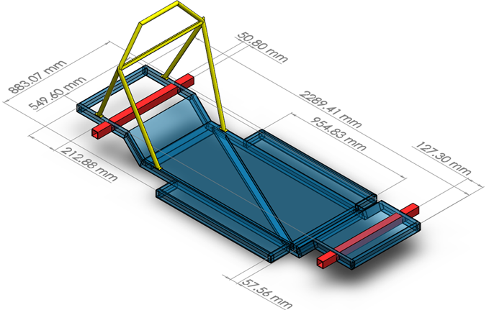
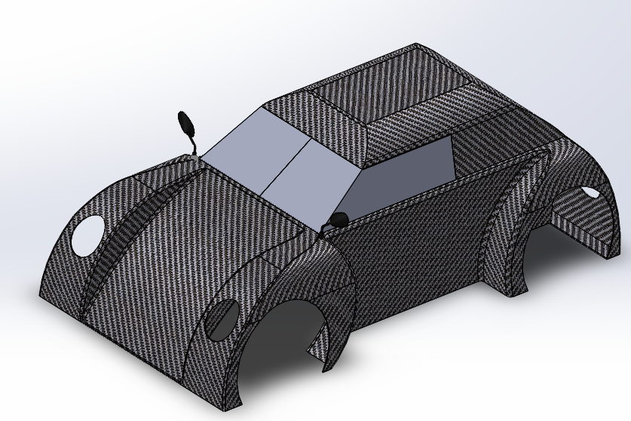

Slide 9
 | Engine | Weight | L48N | L70N | L100N
A | Mass | 0.22 | 42.23 | 32.96 | 25.26
B | Cost | 0.11 | 38.58 | 34.72 | 26.71
C | Power Output | 0.33 | 18.87 | 34.91 | 44.81
D | Size | 0.11 | 44.05 | 31.90 | 24.05
E | Reliability | 0.22 | 33.33 | 33.33 | 33.33
 |  | Total | 32.26 | 33.77 | 33.60
 | Engine | A | B | C | D | E | Total | Weight | Rank
A | Mass | / | 1 | 0 | 1 | 1 | 2 | 0.22 | 2
B | Cost | 0 | / | 0 | 1 | 0 | 1 | 0.11 | 3
C | Power Output | 1 | 1 | / | 1 | 0 | 3 | 0.33 | 1
D | Size | 0 | 0 | 0 | / | 1 | 1 | 0.11 | 3
E | Reliability | 0 | 1 | 1 | 0 | / | 2 | 0.22 | 2
 |  |  |  |  | Total |  | 9 | 1

Slide 10
Criteria | Weight | Transmission type
 |  | Continuously Variable transmission | 1 speed transmission | 5 speed manual transmission | 3 gear transmission (neutral/reverse/forward)
Mass | 0.286 | 20 | 50 | 10 | 20
Cost | 0.190 | 30 | 35 | 15 | 20
Operation difficulty | 0.048 | 40 | 40 | 5 | 15
Installation difficulty | 0.048 | 25 | 30 | 20 | 25
Reliability | 0.143 | 25 | 30 | 25 | 20
Durability | 0.048 | 25 | 25 | 25 | 25
Fuel efficiency | 0.238 | 35 | 20 | 35 | 10
Total weight | 1 | 27.645 | 34.56 | 20 | 17.86
 |  | Weight | Carbon Fiber | Aluminum (6061) | Balsa Wood | Steel (1018)
A | Mass | 0.33 | 40 | 20 | 30 | 10
B | Cost | 0.13 | 10 | 30 | 35 | 25
C | Ease of Manufacturing | 0.07 | 28 | 22 | 20 | 30
D | Reliability | 0.20 | 30 | 30 | 25 | 15
E | Safety | 0.27 | 25 | 25 | 20 | 30
 |  |  | 29.2 | 24.8 | 26.3 | 19.7

Slide 11
Final Chosen Concepts.
Subsystem | Chosen Concept
Engine | Yanmar L70N
Transmission | One Speed Transmission
Differential | No Differential (One Wheel Drive)
Body Shell Design | Hybrid
Body Shell Material | Carbon Fiber
Frame | Replace Aluminum Sheets with Balsa Wood
Suspension | No Suspension
Brake | Hydraulic Brake System
Steering | Mechanical Go Kart Steering

Slide 12
TIMELINE

Slide 13
Conclusion and Discussion

Slide 14
ANY QUESTIONS ?

Slide 15
References:
http://www.shell.com/energy-and-innovation/shell-ecomarathon/asia/news-and-highlights/_jcr_content/pagePromo/image.img.1000.jpeg/1456915443294/shell-eco-marathon-2015-track.jpeg
http://photos.prnewswire.com/prnvar/20120917/MM76045LOGO?max=1600
http://img.cdn2.vietnamnet.vn/Images/english/2015/02/13/16/20150213164336-eco-marathon.jpg
http://shellecomarathon.newsweaver.co.uk/files/1/31964/56654/5550191/83924f8fcc9b533967d2e880/sem_newsweaver_header_asia_banner2_v1_0.jpg
http://www.eventindustrynews.co.uk/wp-content/uploads/2015/06/SEM-Asia-2014-Track-Photo-2.jpg
http://www.shell.com/energy-and-innovation/shell-ecomarathon/about.html
http://www.zinc.uk.com/wp-content/uploads/2012/05/shell-eco-marathon-day-4-2012-5-19-8-20-38.jpg
https://www.google.com/search?q=raspberry+pi+screen+with+gauges&espv=2&biw=1366&bih=667&source=lnms&tbm=isch&sa=X&ved=0ahUKEwi-4JPcgpbPAhWD6RQKHVd8Cw4Q_AUIBygC#imgrc=2LGikGzqZvVxPM%3A

